Slide 1
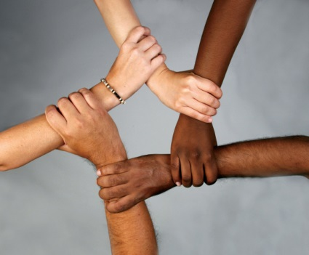
Make racism wrong again Created by: Tiara Odom

Slide 2
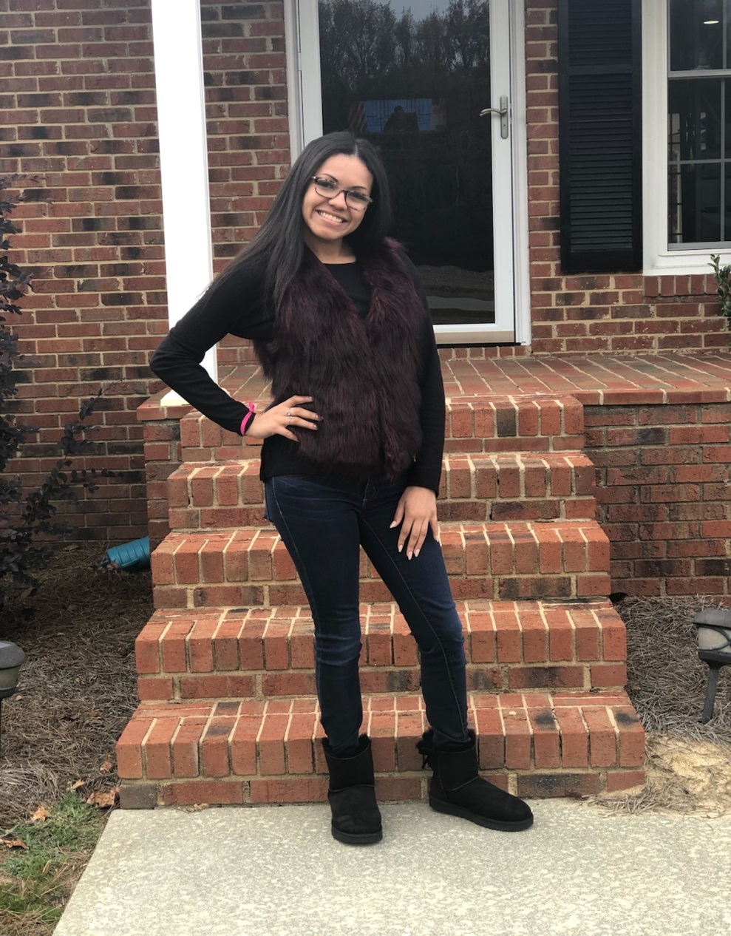
Introduction
Hello everyone! My name is Tiara Odom and I’m twenty years old. Yes, I’m biracial my mom is white and my dad is black because I always get asked that question, so thought I would go ahead and answer it! This racial discussion class has opened my eyes up to a lot and I’d like to share people that have inspired me and I’m glad I had the chance to learn about them in this class!

Slide 3
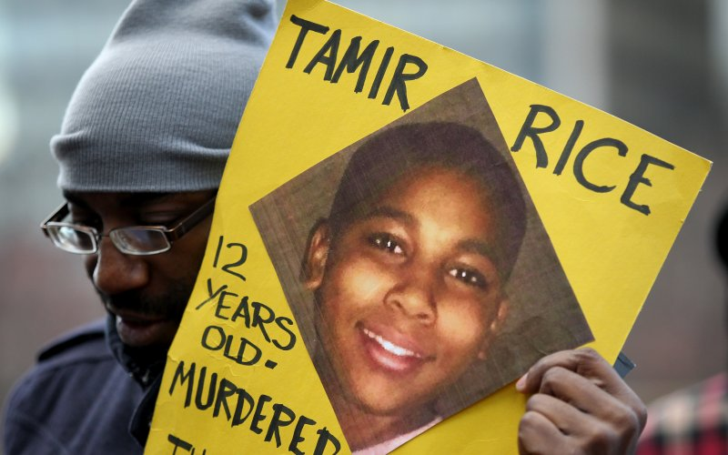
Tamir Rice
https://www.theguardian.com/us-news/video/2014/nov/26/cleveland-video-tamir-rice-shooting-police
The link above is the video of a shooting and killing of 12 year old Tamir Rice by the Cleveland police department.
This video was one of the first things that made me realize racism still exist and police brutality more than we realize.
It breaks my heart to watch it and see an innocent child get killed and imagine how the family feels.

Slide 4
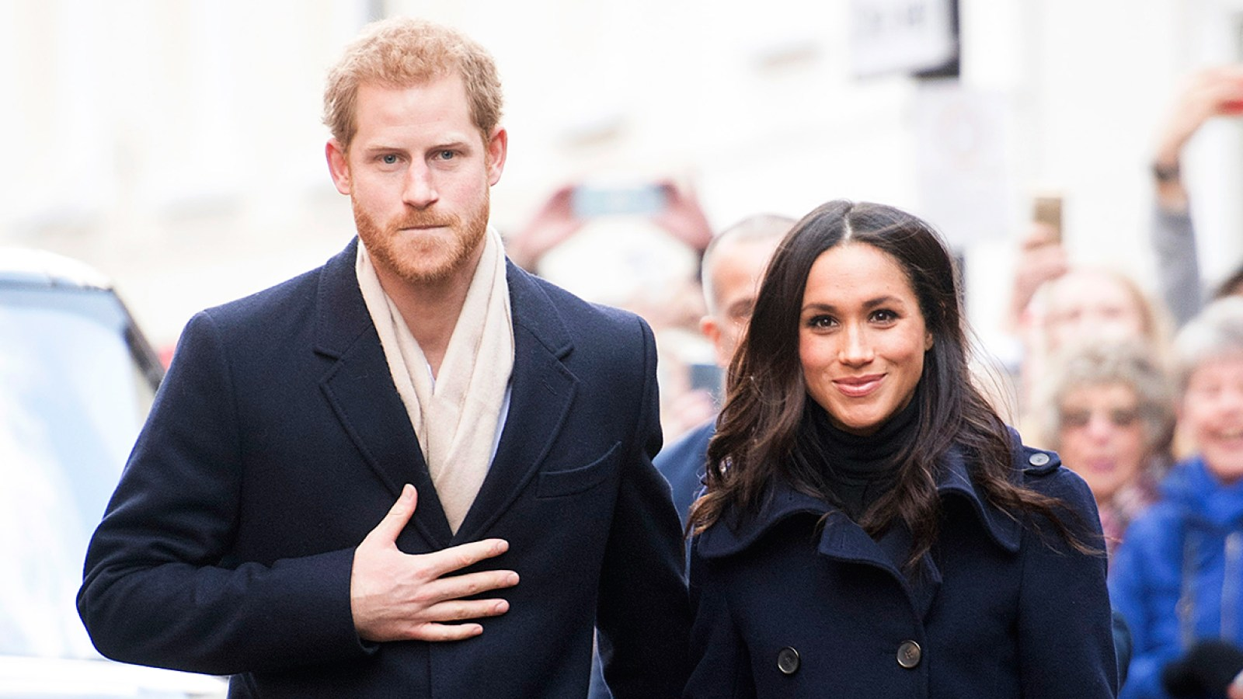
Meghan Markle
The first bi-racial person to be welcomed to the British Royal family!
I struggled with filling out census forms and checking Caucasian or African American because I didn’t want to leave either sides of my family out but she taught me to
“DRAW YOUR OWN BOX AND BE YOUR TRUE SELF!”

Slide 5
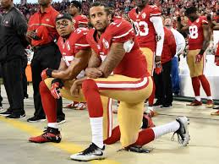
Colin Kaepernick
Protested by kneeling during the national anthem for the mistreatment of minorities, inequality, and the police brutalities occurring!
I love him for starting a peaceful protest and taking a stand and getting the people’s attention of what’s going on in the world!!

Slide 6
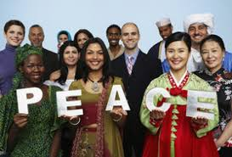
Make a change
If a lot more people would try to make a change in society as these figures have we could all come together as one!
Color shouldn’t define anybody as a person.
“We can’t do everything, but we can do something!” – Ashley Krause

